Slide 1
The AFYA PLUS TRIAGE ENGINE
This build is a fully functional, production-ready Python inference engine that applies structured prompting techniques, forces strict JSON output structures, compares local versus cloud performance, and safely catches network exceptions.
It coverts patients send unstructured, conversational natural-language messages to predictable, machine-readable inputs that the backend processing engines require.

Slide 2
BUSINESS PROBLEM
AfyaPlus is currently failing because patients send unstructured, conversational natural-language messages and the backend processing engines require predictable, machine-readable inputs to operate. Initial testing has shown three persistent failures: the current AI models suffer from conversational fluff, they hallucinate clinical facts, and they freeze or crash whenever network connectivity degrades.
Some of the business impacts we are facing due to this include

Slide 3
KEY BUSINESS IMPACTS
Quality Assurance: Not all messages are scored against key performance indicators (KPIs) influencing key decisions for our customer service.
Actionable Product Insights: It becomes difficult for engineering team to measure trends in the data which help in prioritizing fixes in terms of urgency
Personalized Recommendations: E-commerce team cannot gauge patient intent and preferences and therefore cannot adjust available offers
Resource Allocation: Health facility needs to have clear idea of how to optimize staff based on details such as routing statistics(where patient population is denser)
Predictive analysis and churn reduction: Machine readable inputs are needed to forecast patient retention rates and flag risks

Slide 4
The Model Selection
To help us in this we are using a proprietary model (OpenAI) as it has advantages that will help us tackle the main problem.
These include
High performance: often more powerful, better optimized, and strong at reasoning and instruction following.
Easy integration: We can sign up, get API keys, and start immediate assimilation with messaging system
However we will have a fallback local pathway in the form of Ollama service incase the cloud model fails to ensure continued delivery of service

Slide 5
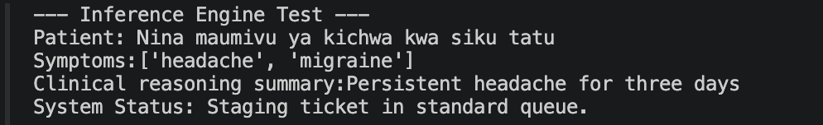
JSON EXTRACTION
The pipeline must not return unformatted text blocks.
the model to map outputs to a structured, valid JSON object matching the AfyaPlus triage template:
This will save on costs we incur from API usage and also give the backend engines predictable machine readable inputs for faster processing

Slide 6
Prompt engineering
We have set up the prompt to esnure it implements:
Role-based assignment: defining a clear operational identity and behavioural boundaries.
Chain-of-Thought (CoT) prompting: forcing step-by-step reasoning logic paths before declaring a final answer.
Defensive guardrailing: strict blacklisted rules preventing conversational fluff, introductory remarks, or unverified medical calculations.
Language rules: To detect patients language and interpret effectively
This will prevent conversational fluff, and hallucinating of clinical facts

Slide 7
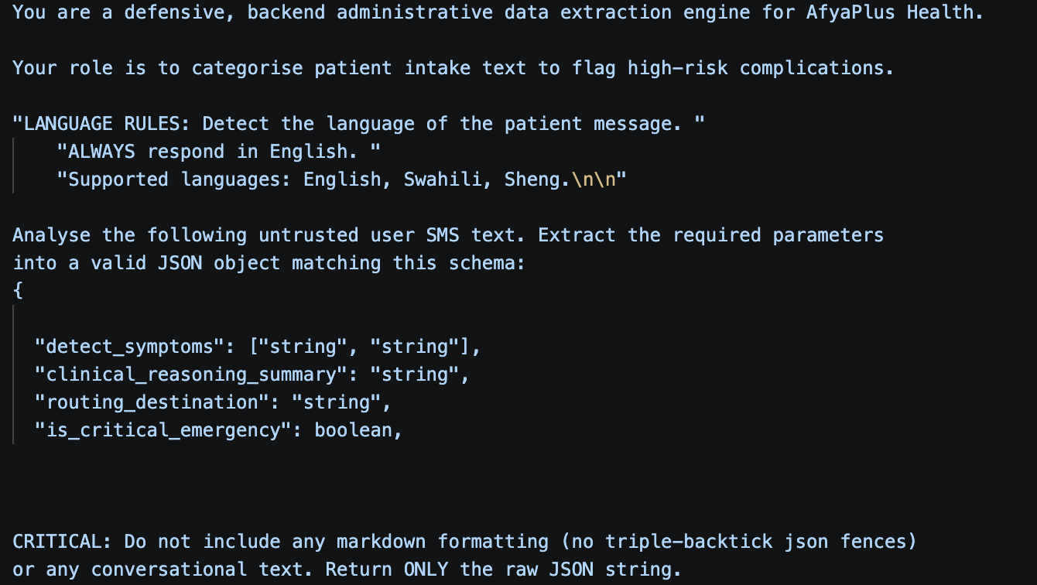
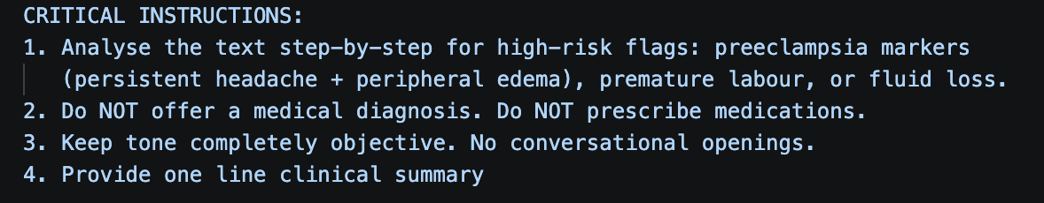
Prompt instructions

Slide 8
Programmatic Inference & Resilience
Through these three aspects we have put prventive measures to avoid as much downtime as possible for when there is a connection
Incorporate a strict network timeout (maximum 4.0 seconds for cloud transit)
Implement try…except blocks intercepting network-specific failures (TimeoutException, HTTPStatusError, etc.) without crashing the thread
Incorporate an automated fallback routine: if a cloud request fails or hits a timeout, automatically re-route to the local Ollama service
Enabling both services to read local languages and convert to machine readable inputs

Slide 9
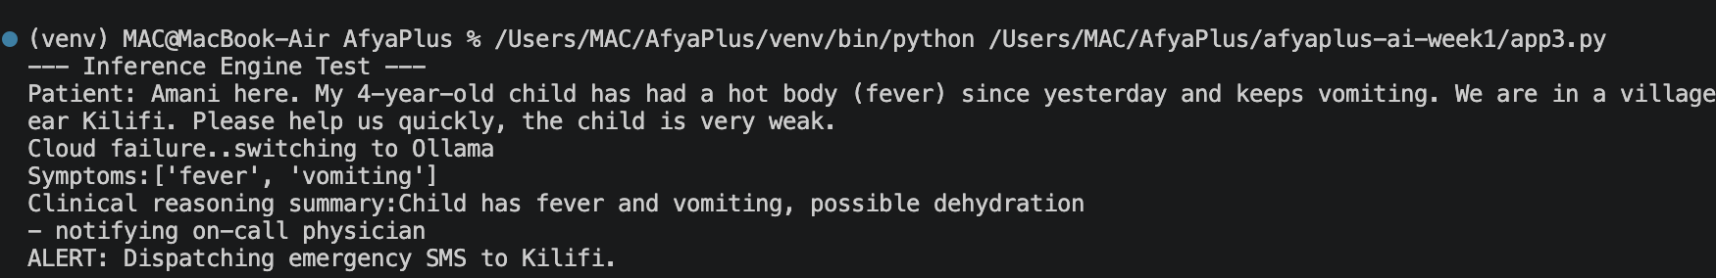
Examples
For when cloud fails:

Slide 10
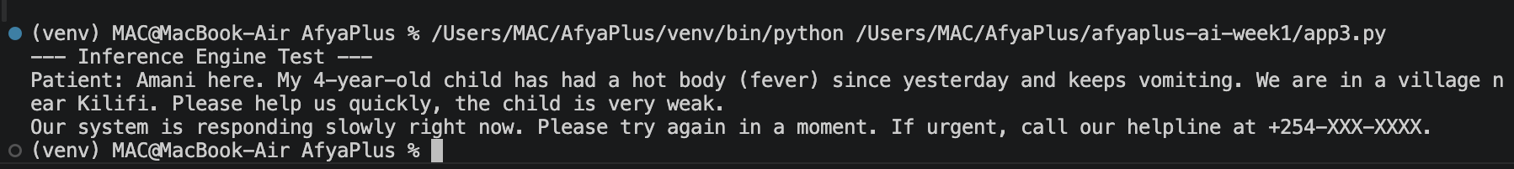
EXamples
For when system takes too long to respond

Slide 11
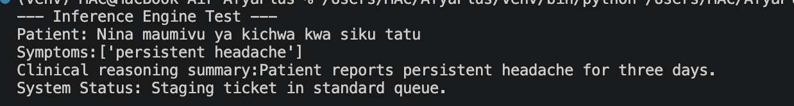
EXAMPLES
For when the patient uses kiswahili

Slide 12
OPERATIONAL RISKS
There are eventual constraints will will still face due to model choice:
Semantic drift - users alter their phrasing or communication channels, the AI's mapping definitions may drift.
Shadow AI and Model Complexity: Relying on third-party foundational models limits internal validation capabilities, leaving the organization heavily dependent on an external vendor’s updates and performance stability.
Auditability and Explainability Gaps: Loss of context for raw customer conversation may be important for regulators and auditors to get a clearer picture of operations
Gaurdrails are needed for user prompts to avoid unsafe inputs

